Slide 1
P1 Progress
Cookie Byte

Slide 2
Hnefatafl
Who wants to try and pronounce this?

Slide 3
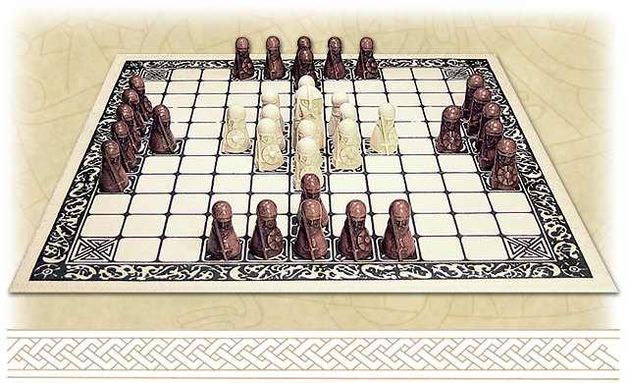
Hnefatafl
Pronunciation: (H)ne-fe-ta-ful
The Viking game
One of the oldest games in the world
Versions traced back to the Romans (Petteia), Greeks, and Egyptians
2 players
Defence has 12 soldiers and 1 king that start in centre of board
Offence has 24 soldiers in groups of 6 on all 4 sides
Goal of game is for defending team to get king to any of the four corners
All pieces move like the rook in chess
Pieces taken by “sandwiching” an opponent’s piece

Slide 4
Product decisions
Potentially set a minimum-length password and other password requirements 10 Characters.
Email, Picture, Nickname required for registration.
Offence and Defence is assigned at random.
User Directory to look up player history.
Web UX/UI.
One invitation per game Instance.
Player history will have winning percentage.

Slide 5
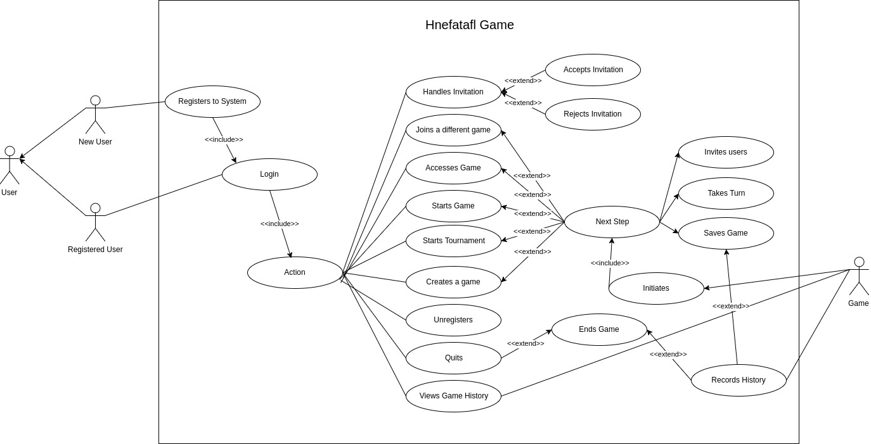
Use Cases

